Slide 1
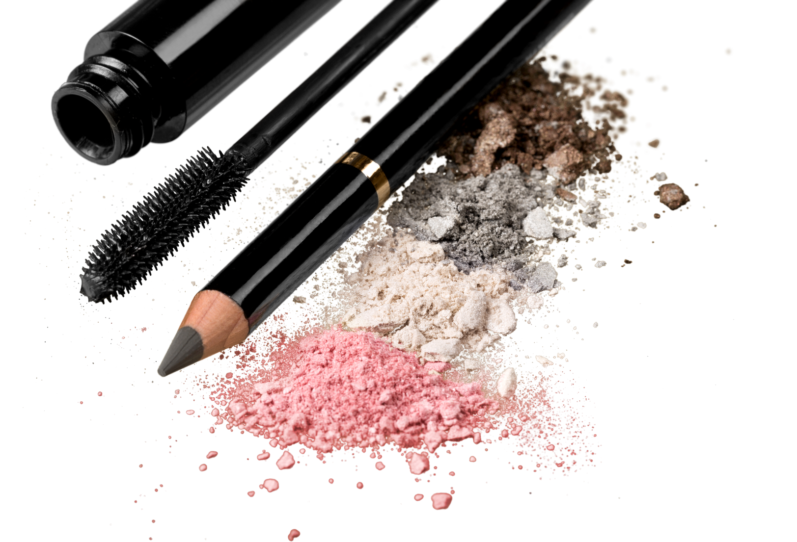


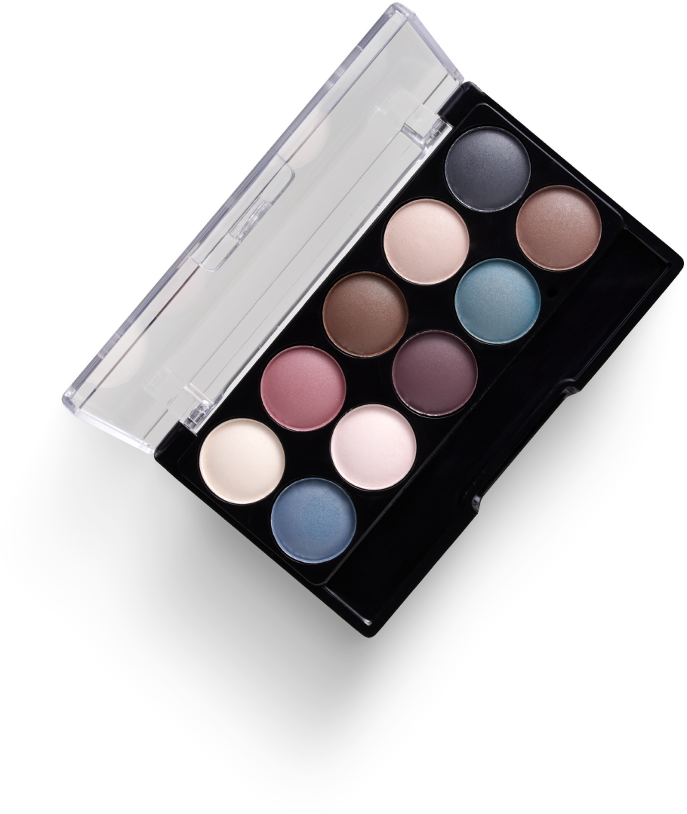
Data Science for Algorithmic Marketing.
Analyzing Beauty Retailers
By Harleen Buttar
March 10th, 2026

Slide 2
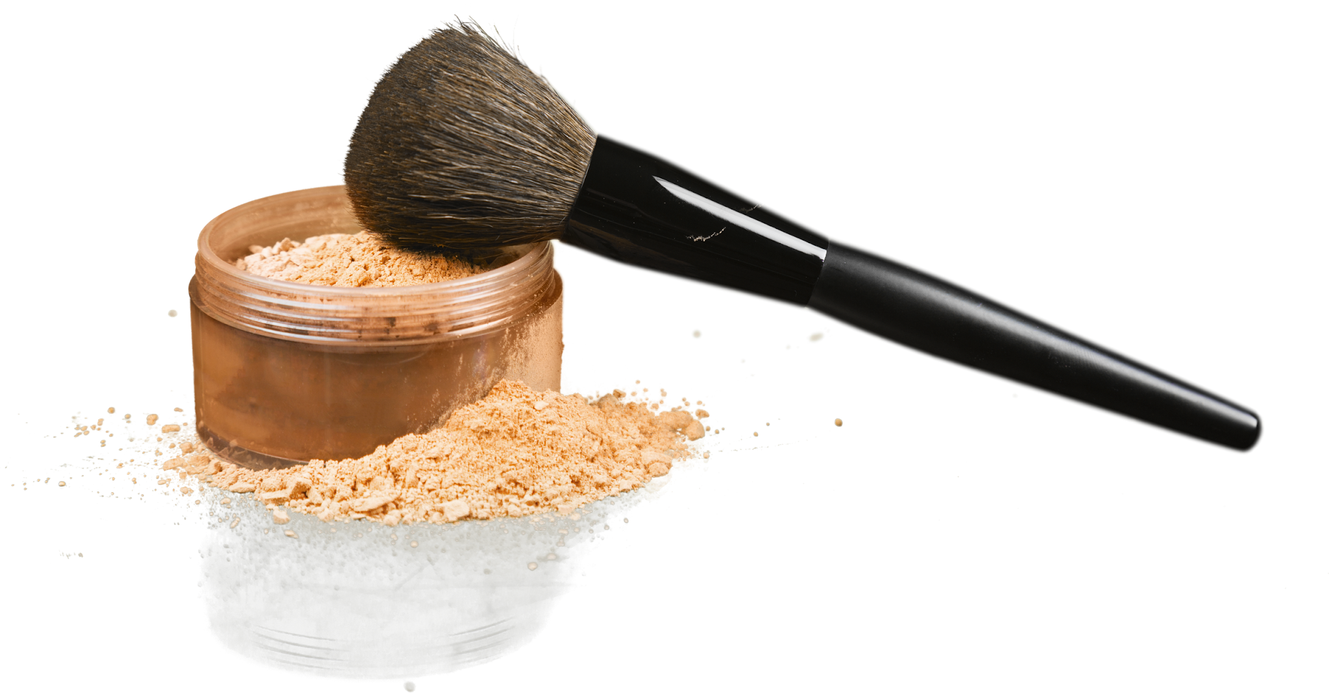
Business Problem
How should beauty brands optimize their product, pricing, and marketing strategies across Sephora and Ulta to maximize perceived value, consumer engagement, and competitive positioning -- given that consumer expectations, sentiment drivers, and price sensitivity may differ by retail channel?

Slide 3
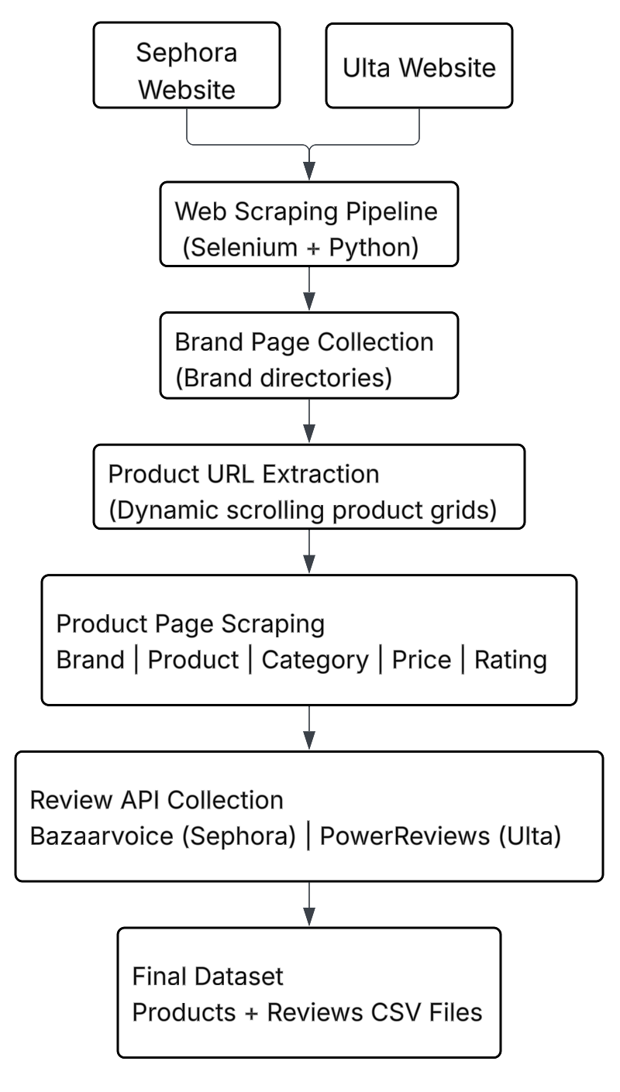
Data Collection
Web Scraping Sephora & Ulta
Automated Data Pipeline
Custom Python scraping framework built using Selenium + BeautifulSoup
Simulated real user browsing to load dynamic product listings
Data Collection Process
Collected brand landing pages from Sephora and Ulta
Extracted product URLs by scrolling product grids
Visited each product page to capture:
Brand
Product name
Category
Price
Rating and review counts
Review Data
Retrieved structured review data through platform APIs:
Bazaarvoice (Sephora)
PowerReviews (Ulta)
Final Dataset
Structured datasets of products + consumer reviews
Enables analysis of brand positioning, sentiment, and cross-platform differences

Slide 4
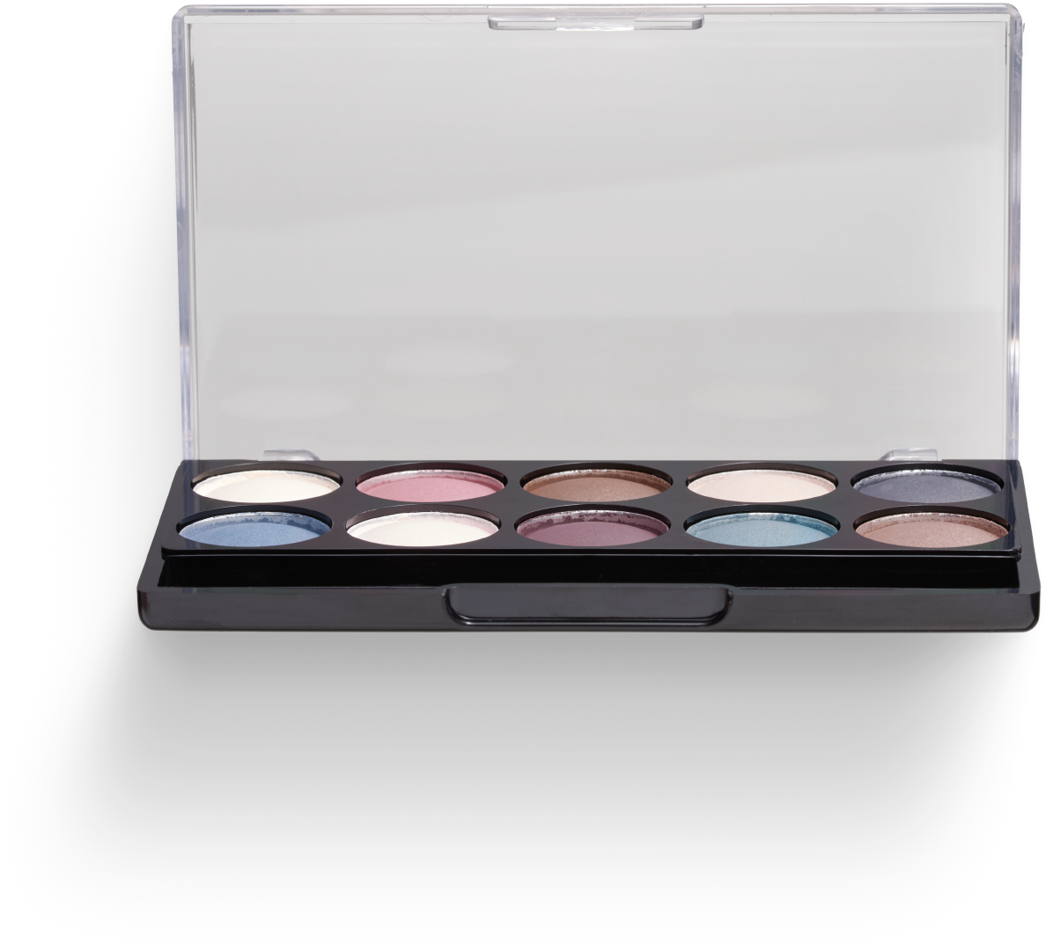
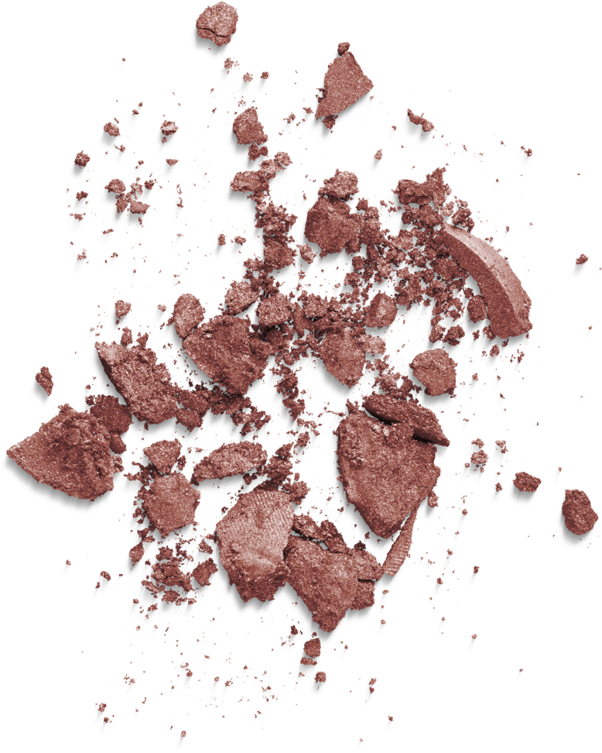
Market Segmentation
Preformed K-means, Hierarchical Clustering, and GMM on both Ulta and Sephora
Weighted and Unweighted
Created segmentation CSVs that included variables like:
Review velocity, Average rating, Positive sentiment ratio, Helpfulness Engagement rate, Rating dispersion over time, Normalized review count, Percent x star ratings, Rating variance/stability, Sentiment scores, Topic Prevalence, and Retailer specific feature
Weights:
Retailer Specific Values
Review Velocity
Positive Sentiment Ratio
Rating Dispersion over time
Rating Variance/Stability

Slide 5
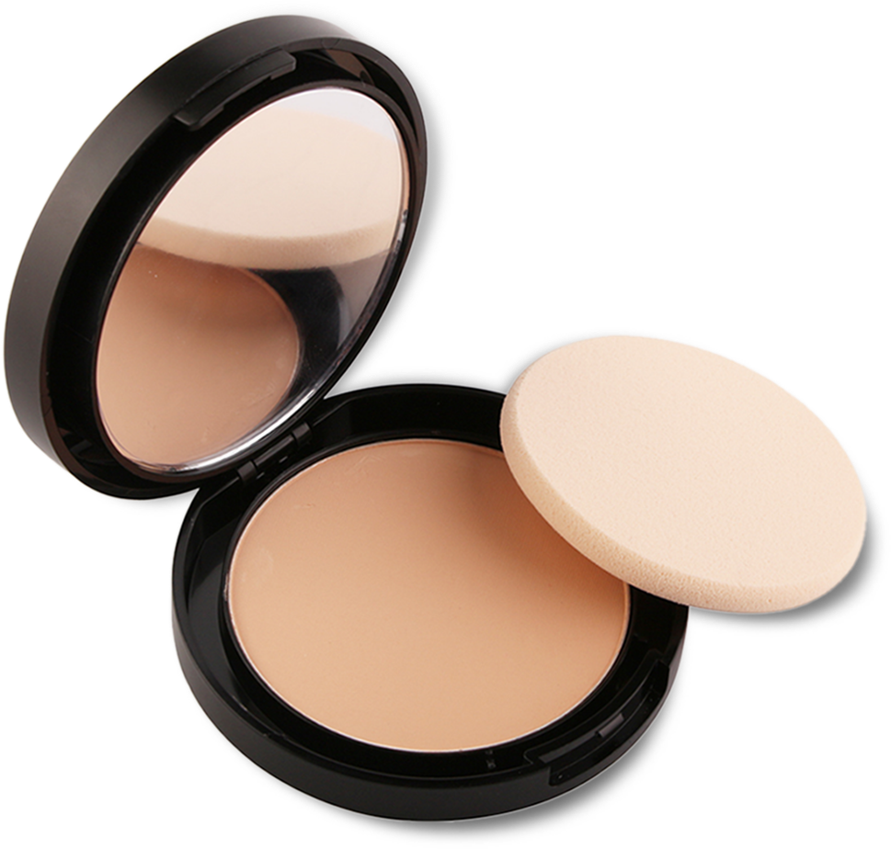
Sephora Weighted K-means
Cluster 0 — High-Traffic Mainstream (614 products, 37.6%)
Cluster 2 — Low-Visibility Darlings (192 products, 11.8%)
Sephora's review engine — 213/month, mostly liked but a 6.4% negative rate generating real debate. Prestige names (Pat McGrath, Merit, Sol de Janeiro) across blush, serums, and fragrance.
Highest-rated cluster (4.63), best sentiment, 17.5 reviews/month — the people who find them love them, almost nobody finds them. Fragrance-heavy, PR-seeded, structurally identical across every model tested.
Cluster 1 — Quiet Loyalists (500 products, 30.6%)
Cluster 3 — Polarizing Problem Children (326 products, 20.0%)
Half the volume of Cluster 0 but better on every quality signal: higher ratings (4.59), stronger sentiment, lower variance. Indie and niche brands with steady, consistently satisfied audiences.
Lowest ratings (3.78), highest variance (1.50 std), 17.1% negative sentiment, and elevated helpfulness scores signaling purchase anxiety. Foundation, mini sizes, established names — high expectations met with vocal disappointment. The intervention queue.
Notes:
Cluster 0 — High-Traffic Mainstream (614 products, 37.6%)
The engine of Sephora's review ecosystem — 213 reviews/month, highest velocity of any cluster. Good ratings (4.37) but a 6.4% negative rate that's double the loyalists. Blush, serums, shampoo, fragrance from recognizable prestige names (Pat McGrath, Merit, Sol de Janeiro). 100% skin tone/type coverage. People buy these, review them a lot, and mostly like them — but there's enough dissatisfaction to generate debate.
Cluster 1 — Quiet Loyalists (500 products, 30.6%)
Half the review velocity of Cluster 0 (86/month) but meaningfully better on every quality signal: higher ratings (4.59), stronger sentiment (80%), lower variance (0.83 std). Niche and indie brands — Pattern, Beauty of Joseon, Harlem Perfume Co. — alongside prestige fragrance. Skincare-heavy. The weighting pulled this out of the old bulk cluster because the stability signal is real: people who find these products consistently agree they're good.
GMM overlay — Quiet Mid-Tier Unknowns (~90 products): Sitting inside this cluster is a sub-population GMM's soft boundaries isolated that K-Means couldn't separate out. Decent ratings (4.45) and solid sentiment (93.3%) — these aren't failing products. They're just invisible, at 30 reviews/month, and skew heavily toward BIPOC-founded and diversity-focused brands (LORE, Range Beauty, ROSE Ingleton MD, Fashion Fair) with the highest deep/rich skin tone representation of any cluster. Different intervention than the broader loyalist group: not optimization, amplification.
Cluster 2 — Low-Visibility Darlings (192 products, 11.8%)
The most structurally distinct cluster in the entire analysis — emerges identically across every model. Highest ratings (4.63), best sentiment (82.8%), lowest variance (0.67), only 17.5 reviews/month. Fragrance-heavy: perfume, gift sets, rollerballs. Zero skin tone data because these are non-skin categories. Heavy PR/gifted review signal (Topic 3 at 24%). The people who find them love them — almost nobody finds them.
GMM confirmation: Assigned 1.000 soft probability across both GMM runs — the highest confidence assignment of any cluster in any model. This group is immovable regardless of algorithm, weighting, or distance metric. The structural signal here is unambiguous.
Cluster 3 — Polarizing Problem Children (326 products, 20.0%)
The sharpest cluster: 3.78 avg rating, 1.50 rating std, 17.1% negative sentiment, highest helpfulness scores (purchase-anxiety behavior). Foundation dominates (shade-matching frustration), plus mini sizes and gift sets generating "not worth the price" reviews. Established names — Kosas, Benefit, NARS — where high expectations meet vocal disappointment. Topic 6 at 32.5% is people narrating their bad experience. This is the intervention queue.
GMM overlay — Critical Failures (61 products): The worst tail of this cluster, concentrated by GMM's weighted run into the most extreme group in the entire analysis. 3.77 avg rating, 1.425 std, 16.4% one-star rate, and a helpfulness score of 10.22 — more than double any other cluster in any model, meaning people are aggressively voting on reviews out of anger or anxiety, not just curiosity. ISAMAYA (5 products), BaBylissPRO, DERMAFLASH — high-expectation brands with structural delivery failures. These 61 products are the delist-or-reformulate watchlist, distinct from the broader polarizing cluster which still has a path to recovery.

Slide 6




Ulta Segmentation
Cluster 1 — Seeded High-Traffic (25.6%)
38.6 reviews/month but the verification signature is the story: 57.3% verified reviewer, only 9.0% verified buyer, 47.4% disclosure rate. High visibility built substantially on incentivized reviews. The question isn't whether the products are good — it's whether the ratings hold when you filter to organic-only.
Cluster 0 — Quiet Loyalists (42.8%)
Best quality signal in the catalog: 4.56 rating, 0.706 std, 93.3% positive sentiment. Organically reviewed, no seeding footprint. The authentic backbone of Ulta's assortment — underexposed and underleveraged.
Cluster 2 — Polarizing Underperformers (31.6%)
Our product range is designed to provide a natural finish, is practical to use, and is suitable for everyday makeup needs as well as special events. Our product range is designed to provide a natural finish, is practical to use, and is suitable for everyday makeup needs as well as special events.
3.83 avg rating, 1.51 std, 1.6 reviews/month. Low traffic and low satisfaction — these aren't generating debate, they're just quietly failing. The delist and formulation review queue.
BUNDLE KITS / LIMITED SETS
Practical packages containing complete products in exclusive packaging, suitable for beginners or gifts.
Notes:
Cluster 0 — Quiet Loyalists (42.8%)
Best quality signal in the catalog: 4.56 rating, 0.706 std, 93.3% positive sentiment. Organically reviewed with no seeding footprint — these are real buyers who consistently agree the products are good. The authentic backbone of Ulta's assortment, currently underexposed and underleveraged.
Cluster 1 — Seeded High-Traffic (25.6%)
38.6 reviews/month, but the verification signature is what defines this cluster: 57.3% verified reviewer, only 9.0% verified buyer, 47.4% disclosure rate. High visibility built substantially on incentivized reviews. This isn't necessarily a quality indictment — it's a provenance question. The intervention isn't "fix the product," it's "audit whether the rating survives when you filter to organic-only," and renegotiate sampling partnerships for brands where it doesn't.
No Sephora parallel: Sephora doesn't expose verification metadata, so this cluster only exists because of Ulta's data structure. At 25.6% of the assortment, it's large enough to be structurally significant — not a statistical edge case. This is the methodological contribution the Ulta dataset makes that Sephora can't: it lets us quantify incentivized review scale at the catalog level.
Cluster 2 — Polarizing Underperformers (31.6%)
3.83 avg rating, 1.51 std, and only 1.6 reviews/month. These aren't generating debate — they're just quietly failing. Low traffic and low satisfaction is the worst combination: not enough engagement to course-correct through review feedback, not enough loyalty to justify shelf space. The delist and formulation review queue.

Slide 7
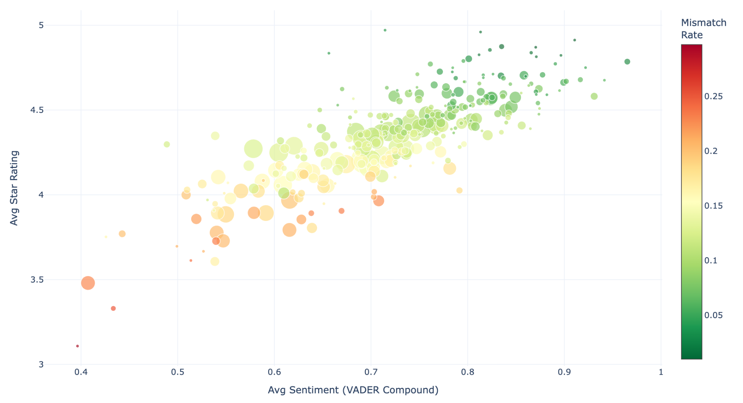
Sephora Brand Health Overview
The beauty industry continues to experience significant growth along with the increasing interest in makeup that is practical, quality, and in line with modern lifestyles. Consumers are now more aware of product content, comfort, and natural looks.
Notes:
Slide setup — what to tell the audience before they read it:
Three variables at once: sentiment on X, star rating on Y, review volume as size, mismatch rate as color. Tell them to look for where those four signals disagree — that's where the interesting brands live.
Opening line:
"If sentiment and star ratings were perfectly aligned, every bubble would fall on a clean diagonal and be green. Most do. The ones that don't are the ones we care about."
Walk the chart left to right:
Bottom-left (orange/red, below 4.0 stars, below 0.65 sentiment): brands in active trouble. Low ratings, negative written sentiment, high mismatch — reviewers can't agree on how bad it is, which is often worse than consistent low ratings. The large orange bubble near (0.40, 3.5) is your anchor example: high volume, low satisfaction, high mismatch. A brand with a real audience that it's losing.
Middle transition zone (yellow, 0.55–0.70 sentiment): the "at risk" tier. Ratings are recovering but mismatch is still elevated — these are brands where the written experience and the star aren't telling the same story yet. Could go either way with the right intervention.
Upper-right (green, 0.75+ sentiment, 4.3+ rating): the healthy core. Most of Sephora's large-volume brands live here. Green and stable, but crowded — this chart doesn't help you differentiate within the healthy tier, it helps you identify what's falling out of it.
The mismatch rate point — worth emphasizing:
Mismatch rate is doing something star rating alone can't. A brand at 3.8 stars with low mismatch means everyone agrees it's mediocre — manageable, predictable. A brand at 3.8 stars with high mismatch means the audience is polarized — some people love it, some hate it, and neither group is being served well. The color dimension separates those two very different problems.
Connecting back to clustering:
This chart is a visual rendering of what K-Means Cluster 3 quantified. The bottom-left orange cluster is approximately your Polarizing Problem Children — high mismatch, low sentiment, low rating. The upper-right green mass is approximately Clusters 0 and 1. The chart gives you spatial intuition for why those segments separated the way they did.
What this chart can't show — say this explicitly:
Review volume (bubble size) can be misleading without context. A small green bubble in the upper-right could be a Low-Visibility Darling — beloved by few — or just a new product. Size alone doesn't distinguish low-discovery from low-demand. That's what the clustering adds on top of this visualization.

Slide 8
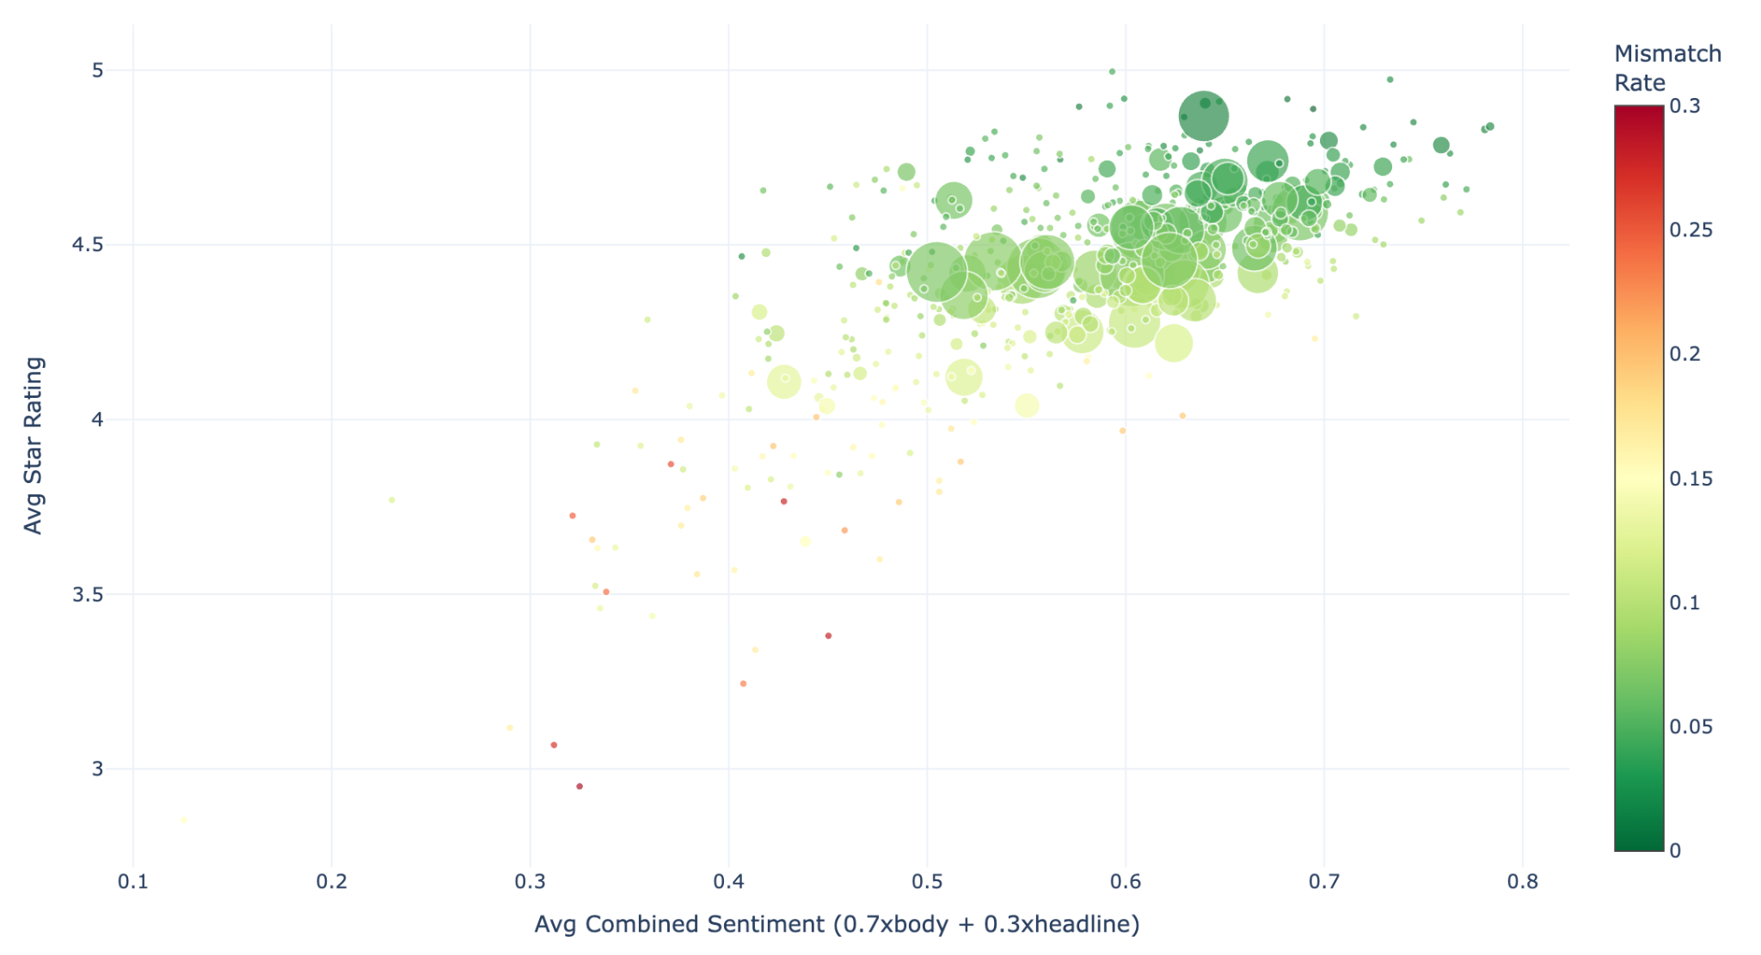
Ulta Brand Health Overview
CONSUMER TARGET SEGMENTATION
Likes to try new trends
Prioritizes comfort and efficiency
Prefers products that are light and hassle-free
Concerns about material safety and product aesthetics
(late teens to young adults who are active on social media and follow beauty trends)
Makeup that is practical, easy to use, buildable (can be adjusted), and looks natural. Makeup that is practical, easy to use, buildable (can be adjusted), and looks natural.
Dynamic, multitasking, looking for products that support daily activities with maximum results. Dynamic, multitasking, looking for products that support daily activities with maximum results.
Notes:
Slide setup — what to tell the audience before they read it:
Same four-variable structure as Sephora: sentiment on X, star rating on Y, review volume as size, mismatch rate as color. One key difference: the X-axis here is a combined sentiment score (0.7× body + 0.3× headline), not raw VADER — headline sentiment is being weighted in because Ulta review titles carry meaningful signal.
Opening line:
"Compared to Sephora, this chart is overwhelmingly green. That's not because Ulta's products are better — it's because a significant portion of the review corpus is incentivized, and incentivized reviews skew positive and low-mismatch by design."
Walk the chart left to right:
Bottom-left (red/orange, below 3.8 stars, below 0.35 sentiment): tiny cluster of genuinely failing brands. Very low volume — small dots — meaning these are niche products with bad reception, not high-traffic disasters. The two red dots near (0.32, 3.0) and (0.32, 2.9) are the most extreme failures in the catalog, but their small size means limited exposure.
Middle zone (yellow, 0.35–0.55 sentiment): the at-risk tier, mostly small bubbles. Mismatch is moderate — these brands aren't catastrophically polarizing but sentiment and ratings aren't aligned. Worth monitoring.
Upper-right mass (green, 0.55+ sentiment, 4.3+ rating): where almost everything lives. Dominated by large, dark green bubbles — high volume, high sentiment, very low mismatch. This density is the seeded cluster's fingerprint. Incentivized reviews produce exactly this pattern: high ratings, positive written sentiment, consistent agreement (low mismatch) because the reviewer population is curated.
The critical comparison to Sephora:
Sephora's chart had a wide spread — brands distributed across the full sentiment and rating range, with visible orange and red throughout. Ulta's chart is compressed into the upper-right. That compression is partly real product quality, but partly a structural artifact of the verification program. When nearly half of reviews in a cluster carry a disclosure, the brand health overview inherits that bias. The chart looks healthy because the review ecosystem is managed, not necessarily because the products are better.
The mismatch rate point:
The large dark green bubbles in the 0.6–0.7 sentiment range are doing something interesting — high volume, low mismatch, strong ratings. In isolation that looks like the Quiet Loyalists. But cross-referencing with the clustering: some of these are Seeded High-Traffic brands where the low mismatch comes from a homogeneous incentivized reviewer pool, not genuine organic consensus. Low mismatch on Ulta means something different than low mismatch on Sephora.
Connecting back to clustering:
The upper-right green mass contains both Quiet Loyalists and Seeded High-Traffic brands visually indistinguishable from each other here. That's exactly why the verification metadata was essential to the clustering — this chart alone can't separate them. K-Means weighted did what the visualization couldn't: split that green mass by provenance, not just by quality signal.
What this chart can't show — say this explicitly:
Without the verification layer, Ulta looks like a healthier catalog than Sephora. That reading is probably wrong. The chart is showing you review ecosystem output, not ground-truth product quality. The clustering is what lets you ask whether the green is earned or manufactured.

Slide 9
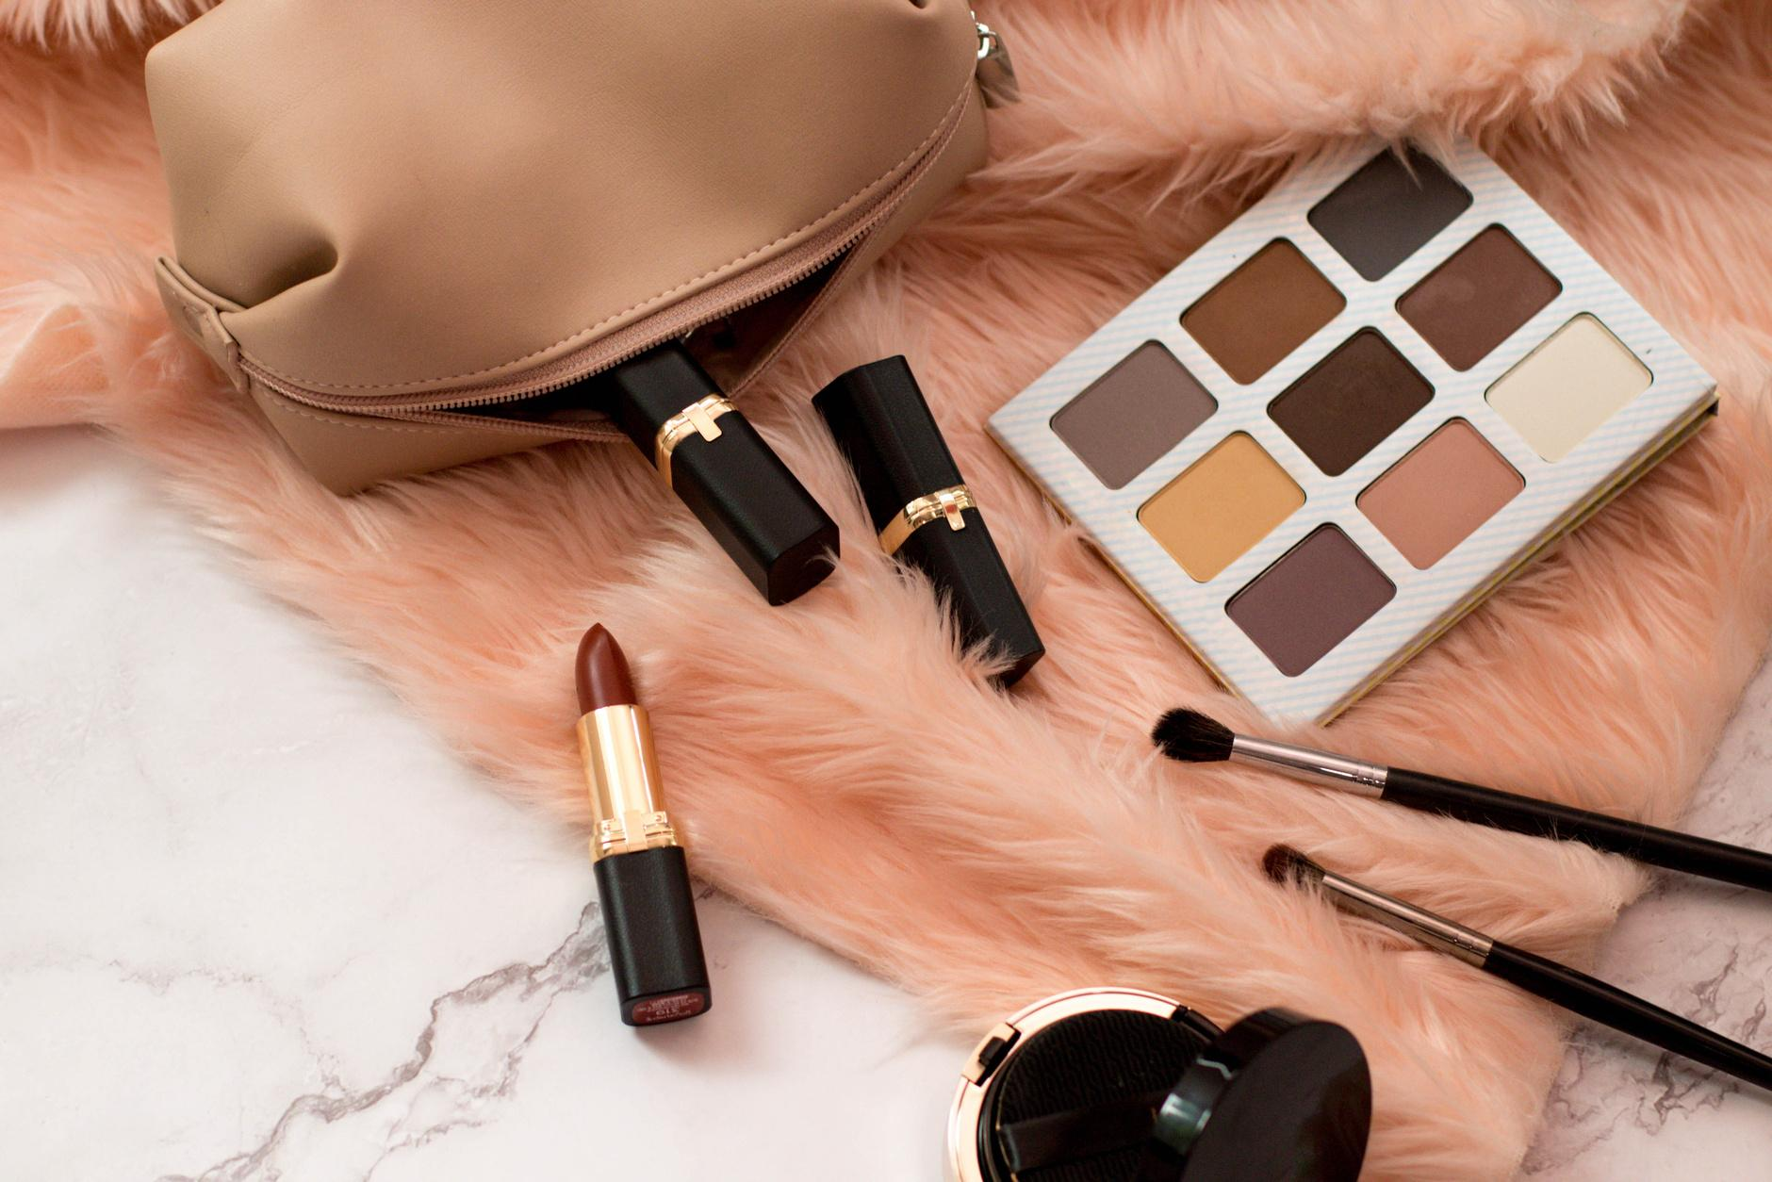

Brand Health Dashboard
DEMO

Slide 10
Recommendations
DEMO

Slide 11
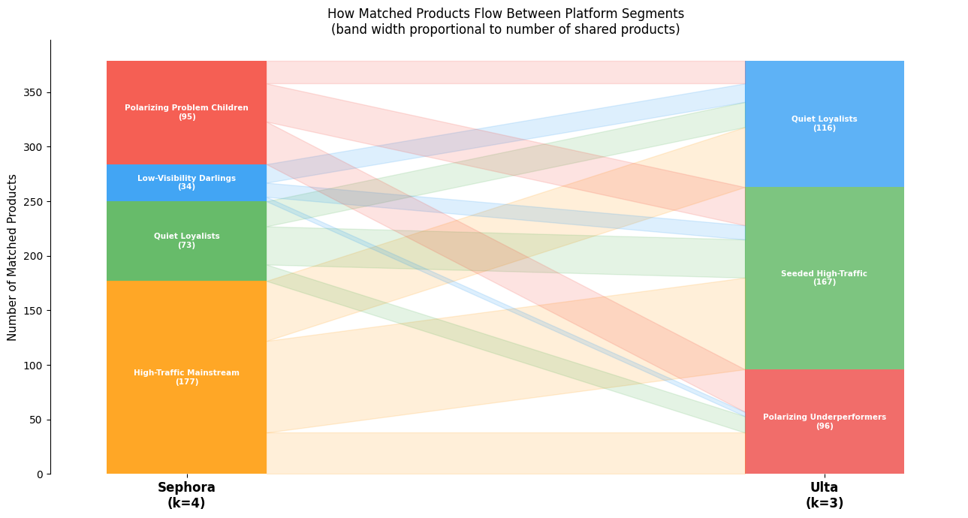
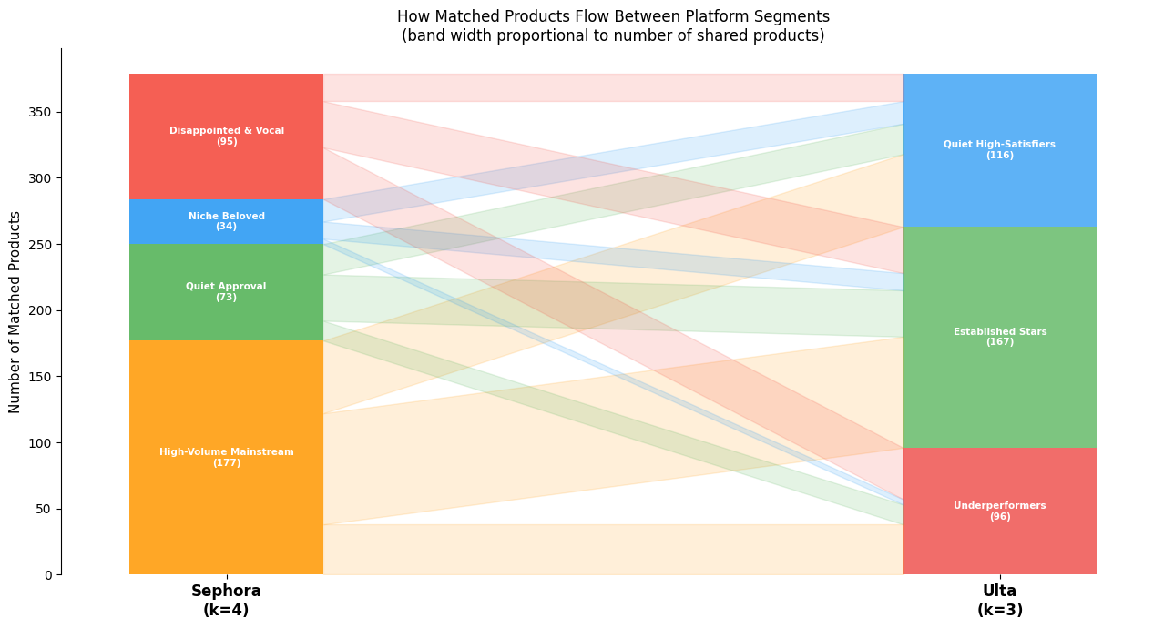
Cross Platform Segmentation Comparison
Low alignment across platforms
Sephora signals dont reliably transfer
Most stable segment: Niche beloved
Most revealing asymmetry: Nearly 60% of Sephora’s “Disappointed & Vocal” products appear as neutral or positive performers on Ulta
Price parity holds
Brand Consistency varies widely
COSMETICS MARKET GROWTH (2021-2025)
Notes:
Low alignment across platforms: Only 33.5% of matched products land in the same quality tier on Sephora and Ulta; 66.5% shift tiers, confirming quality perception is platform-relative, not intrinsic.
Sephora signals don’t reliably transfer: High-volume or positively received products on Sephora show little predictive power for Ulta tier placement; Sephora’s volume-based distinctions largely collapse in Ulta’s context.
Most stable segment: Low Visibility Darlings products exhibit the strongest cross-platform consistency, with 88% landing in Ulta’s positive tiers and near-identical ratings across platforms.
Most revealing asymmetry: Nearly 60% of Sephora’s “Polarizing Problem Children” products appear as neutral or positive performers on Ulta, indicating Sephora amplifies dissatisfaction due to higher expectations and a more vocal review culture.
Price parity holds: Cross-listed products are priced similarly on both platforms; tier shifts are driven by perception, not pricing.
Brand consistency varies widely: Some brands show near-perfect alignment, while many prestige and category-specific brands experience substantial tier migration, driven by category framing and consumer expectations rather than product quality.

Slide 12
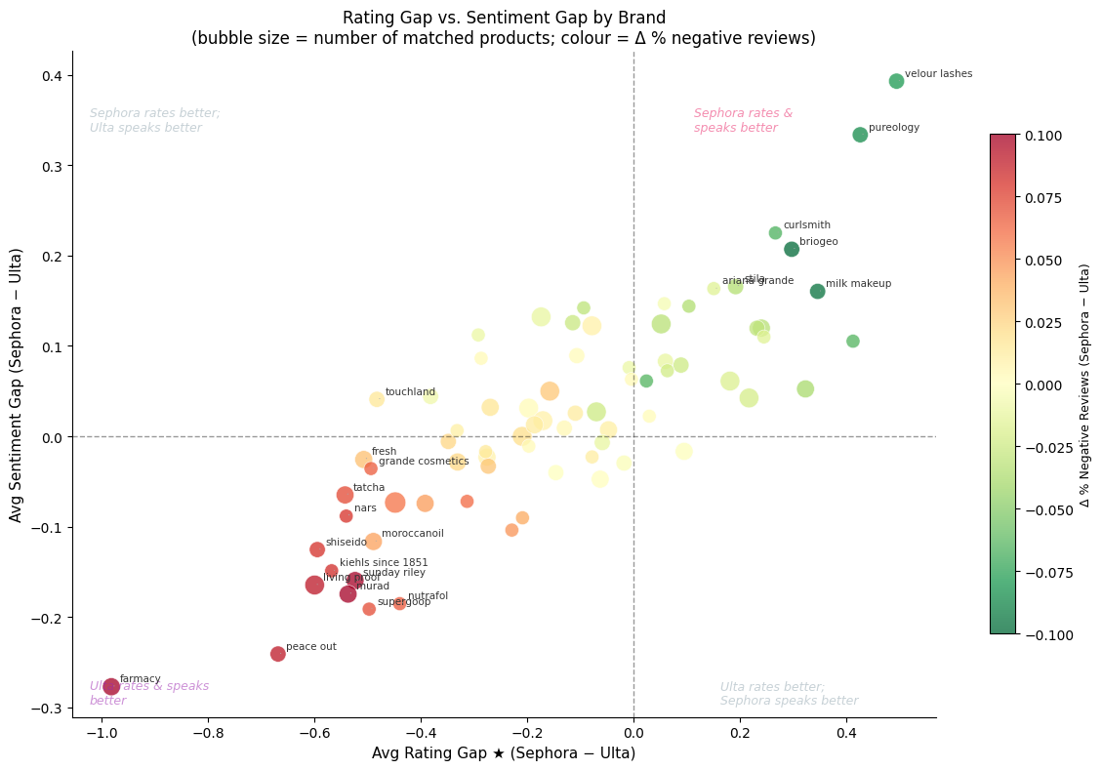
Sentiment Gap Analysis
Platform calibration differs
Same products score differently
Our product range is designed to provide a natural finish, is practical to use, and is suitable for everyday makeup needs as well as special events. Our product range is designed to provide a natural finish, is practical to use, and is suitable for everyday makeup needs as well as special events.
Clear brand & category splits
Context drives delighters
Notes:
Bottom line: Sentiment and ratings are platform-calibrated signals, not universal quality measures. Cross-channel performance differences reflect consumer expectations, category framing, and evaluation norms, requiring platform-specific interpretation and strategy. Platform calibration differs: Sephora reviews use more positive language but stricter star ratings, while Ulta reviewers give higher stars with less effusive text — sentiment and ratings capture different evaluation norms, not contradictions. Pasted text
Same products score differently: For matched SKUs, Sephora sentiment is slightly higher, but Ulta rates higher on 68% of products (−0.15 star gap on Sephora), indicating a structural rating calibration effect, not product quality differences. Pasted text
Clear brand & category splits: Sephora-favored performance haircare, clean beauty, color cosmetics, and fragrance; Ulta-favored functional skincare and treatment categories, driven by different expectation benchmarks. Pasted text
Context drives delighters: The largest sentiment gaps align with each platform’s strengths — Sephora amplifies specialist appreciation, while Ulta elevates professional tools and functional efficacy products — reinforcing that reputation is platform-dependent.

Slide 13
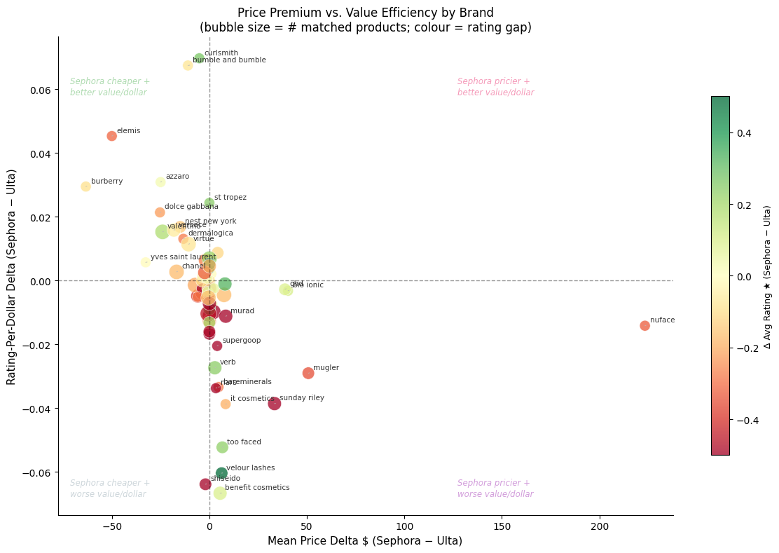
Price Consistency & Perceived Value
Price parity dominates
Structured deviations by tier & category
Brand outliers are category-driven
Higher price ≠ better experience
Notes:
Price parity dominates: Nearly 68% of matched products are priced within $1 across platforms, with a median price gap of $0 and no systematic Sephora or Ulta premium — price is largely constant across channels.
Structured deviations by tier & category: Small Sephora premiums appear at budget/mid tiers, while Ulta prices higher in luxury ($75–150), especially for designer fragrance and gifting formats; devices and prestige tools drive most large Sephora premiums.
Brand outliers are category-driven: Extreme gaps (e.g., NuFACE devices higher at Sephora; luxury fragrance houses higher at Ulta) reflect category-specific pricing norms, not broad brand mispricing.
Higher price ≠ better experience: No relationship between paying more and receiving better ratings or sentiment; Ulta shows slightly higher rating-per-dollar, while sentiment-per-dollar is equivalent — value differences stem from platform rating culture, not pricing.

Slide 14
Joint Recommendations
DEMO

Slide 15
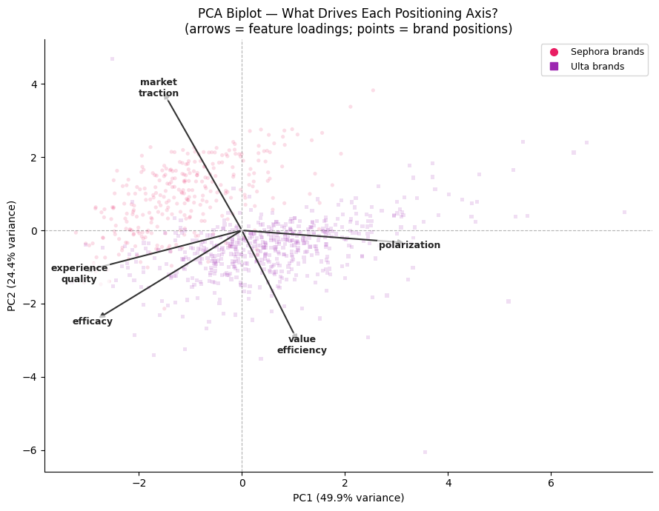
Competitive Positioning
Two axes define competitive position
Platform landscapes differ structurally
Channel shifts brand perception
Tier structures are not interchangeable
Value efficiency diverges by platform
5,000
Sold more than 5,000 units in the first 3 months after launch
Notes:
Two axes define competitive position: PCA explains 74% of variance with PC1 = Quality vs. Divisiveness and PC2 = Visibility vs. Value Efficiency, cleanly summarizing how brands compete.
Platform landscapes differ structurally: Sephora brands cluster around high efficacy and experience quality, while Ulta spans a much wider quality and polarization range, driven by mass-market brands.
Channel shifts brand perception: The same brands are consistently more polarizing on Ulta than on Sephora, indicating a platform-driven perception effect beyond product mix differences.
Tier structures are not interchangeable: Sephora’s Premium Leaders are aspirational and identity-led; Ulta’s Premium Leaders show high polarization but low traction and value efficiency, a segment with no Sephora equivalent.
Value efficiency diverges by platform: Premium pricing suppresses value efficiency at Sephora, while it becomes a key differentiator at Ulta for mass-accessible brands — reflecting different consumer value contracts across platforms.

Slide 16
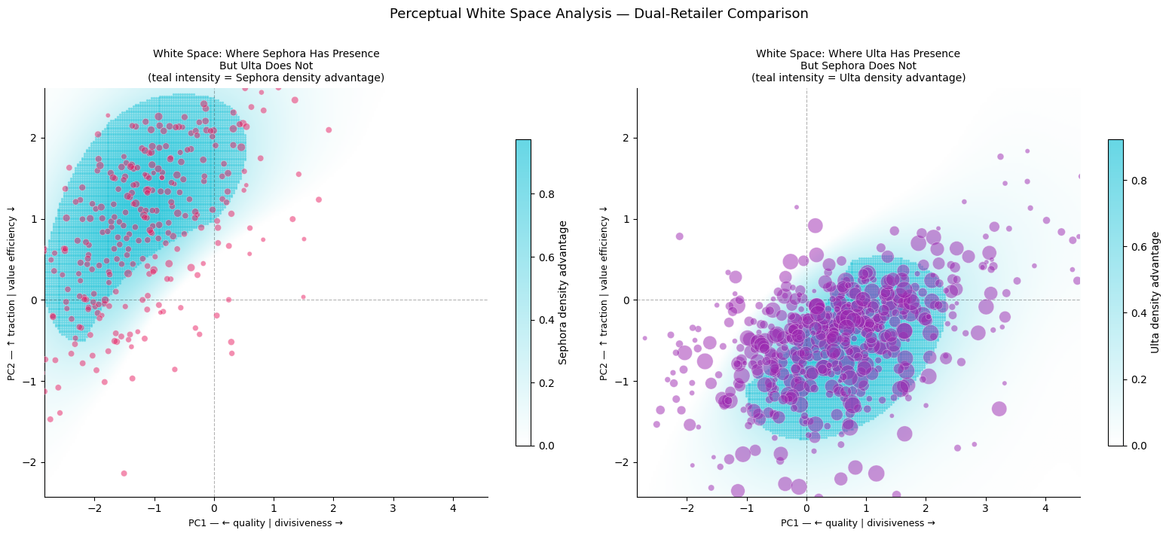
Perceptual Mapping
* Distinct platform topologies * Asymmetric white space * Different value contracts
COSMETICS MARKET GROWTH (2021-2025)
Notes:
Distinct platform topologies: Sephora concentrates in the beloved, high-quality, high-traction quadrant, while Ulta spans a much broader quality range, extending far into polarizing, mass-accessible territory that Sephora largely avoids.
Asymmetric white space: Sephora dominates the upper-left (beloved + visible) space with almost no Ulta presence; Ulta dominates the mid-quality, high-volume accessible zone. Ulta’s growth opportunity is upward (prestige), while Sephora’s absence reflects strategic choice, not weakness.
Different value contracts: Sephora’s “overpriced” zone is concentrated among beloved prestige tools/devices where consumers tolerate premiums; Ulta’s overpriced zone is dominated by luxury fashion and fragrance brands, while its underpriced zone highlights strong value efficiency in mass skincare and haircare.
Price perception shifts are one-sided and independent: Most shared brands appear more overpriced on Ulta than Sephora, especially luxury and premium hardware, and price perception shifts are uncorrelated with quality/divisiveness shifts, requiring separate strategic levers.
Clear repositioning archetypes emerge: Shared brands split evenly into Cross-Platform Anchors, Needs Intervention, Ulta Expansion Candidates, and Sephora Repositioning Targets, while Sephora-exclusive brands in the high-traction prestige zone represent the most credible, data-backed Ulta white-space opportunities.

Slide 17
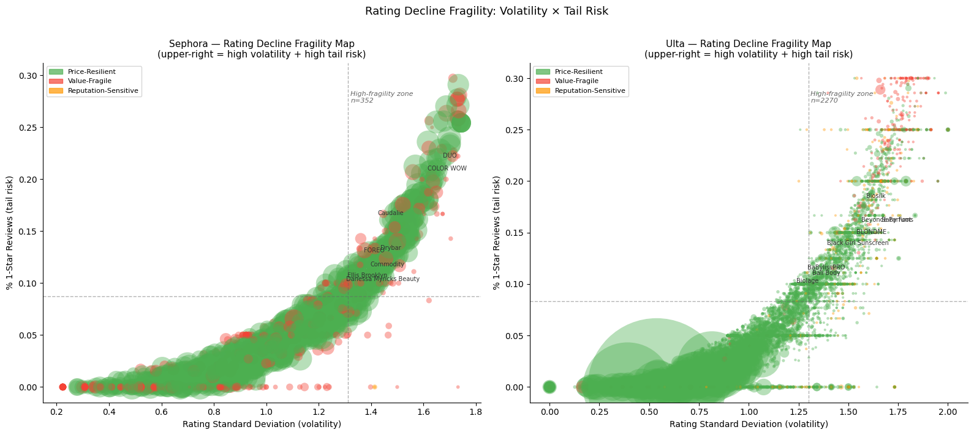
Perceived Value, Price Context and Demand Sensitivity
Demand sensitivity is platform-conditional
Sentiment drives demand on Sephora, not Ulta
Price deviation behaves oppositely by channel
Fragility is not a product trait
Our product range is designed to provide a natural finish, is practical to use, and is suitable for everyday makeup needs as well
Notes:
Demand sensitivity is platform-conditional: Sephora has a meaningful Value-Fragile minority (≈33%), while Ulta’s catalog is overwhelmingly Price-Resilient (≈89%), reflecting Sephora’s prestige, sentiment-driven demand versus Ulta’s mass, baseline-driven demand. Pasted markdown
Sentiment drives demand on Sephora, not Ulta: On Sephora, review sentiment and demand are strongly coupled (median coupling ≈0.41), making negative sentiment a leading indicator of velocity loss; on Ulta, sentiment and demand are almost fully decoupled (median ≈0). Pasted markdown
Price deviation behaves oppositely by channel: On Sephora, pricing above category norms slightly increases demand, consistent with prestige signaling; on Ulta, price deviation has no measurable effect on review velocity. Pasted markdown
Shock response differs sharply: Sephora’s Value-Fragile products collapse after negative-review thresholds, while Price-Resilient products absorb controversy; on Ulta, both archetypes converge to low, flat velocity, limiting differentiation. Pasted markdown
Fragility is not a product trait: 94% of Sephora Price-Resilient products remain resilient on Ulta, but >95% of Sephora Value-Fragile products become resilient on Ulta, proving demand fragility is channel-driven, not intrinsic.

Slide 18
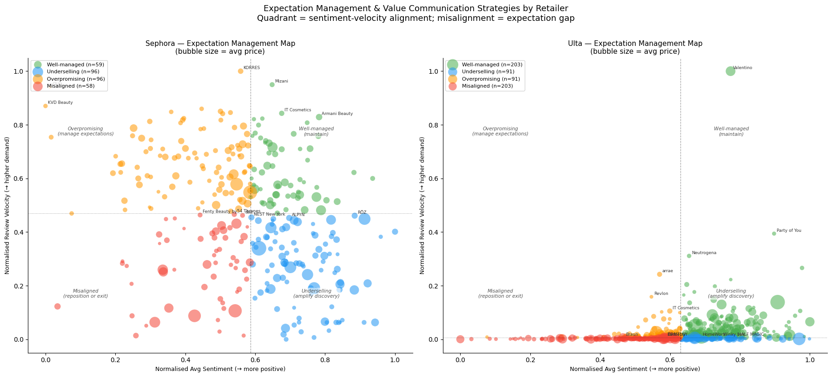
Cross Retailer Simulations
Negative review shocks increase demand, not suppress it
Platforms are mostly informationally independent
Price sensitivity is brand- and channel-specific
Ulta dominates value conversion
Notes:
Negative review shocks increase demand, not suppress it: On both platforms, negative sentiment spikes trigger large, sustained velocity increases (≈2×–2.5×), with spillovers often stronger cross-platform than on the origin platform, confirming a controversy-driven engagement effect rather than reputational collapse. Pasted markdown
Platforms are mostly informationally independent: Granger causality shows 90%+ of brands exhibit no lead–lag relationship between Sephora and Ulta; cross-platform sentiment propagation exists but is limited to a small set of high-visibility brands. Pasted markdown
Price sensitivity is brand- and channel-specific: Most brands show near-zero price sensitivity, but outliers diverge sharply by platform, with prestige makeup/fragrance more price-sensitive on Sephora and haircare/tools more sensitive on Ulta — requiring channel-specific pricing strategies. Pasted markdown
Ulta dominates value conversion: Over 50% of shared brands are Ulta-optimised, converting sentiment into demand on Ulta but not Sephora; no brand is Sephora-optimised, underscoring Ulta’s advantage in translating reviews into incremental demand. Pasted markdown

Slide 19
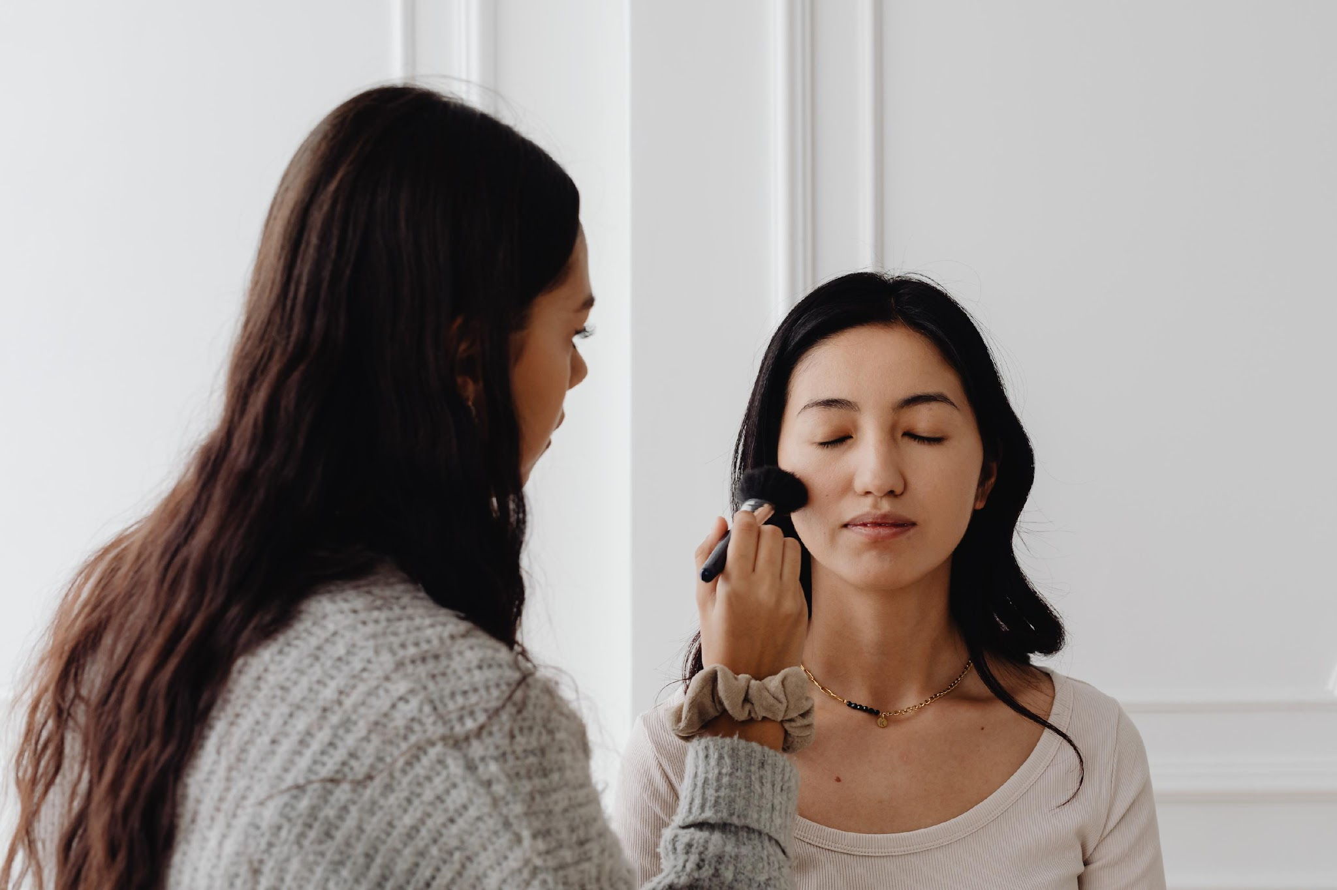

Causal Attribution
Negative review shocks are engagement catalysts
Price tier moderates shock impact on Sephora
But shocks causally damage perceived quality
Ulta reacts differently to price context
Spillovers affect attention, not belief
Recovery is partial, not complete
“42% of users complain that their makeup doesn't last long”
Notes:
Negative review shocks are engagement catalysts: Difference-in-Differences estimates show shocks causally increase review velocity on both platforms (+1.36/month on Sephora, +0.99 on Ulta), confirming controversy attracts attention rather than suppressing demand. Pasted text
But shocks causally damage perceived quality: The same shocks reduce average ratings and sentiment (≈−0.33 stars on Sephora, −0.26 on Ulta; sentiment drops 36% more on Sephora), creating a velocity–quality tradeoff. Pasted text
Recovery is partial, not complete: Roughly 45% of products fully recover, ~30% show no recovery, and median velocity remains 25–30% below shock-month peaks after four months; ratings rebound meaningfully but do not return to baseline. Pasted text
Price tier moderates shock impact on Sephora: The $20–40 tier benefits most from shocks, while the $40–75 mid-prestige tier is uniquely harmed (negative causal velocity effect), making it the highest-risk segment for reputation shocks. Pasted text
Ulta reacts differently to price context: On Ulta, all tiers are neutral-to-positive, with the $150+ tier benefiting most from shocks, reflecting investigative behavior around premium products rather than demand suppression. Pasted text
Spillovers affect attention, not belief: Sephora shocks erode Ulta’s velocity advantage for cross-listed products but do not causally affect Ulta ratings, indicating attention spills over, quality perception does not.

Slide 20
Convergent Strategic Recommendations
Adopt a platform-differentiated growth system, not a unified brand strategy.
Use segmentation as the operating backbone for every decision
Optimize for visibility where quality is proven, and for quality where visibility is unavoidable
Treat reputation shocks as attention events, not crises — except where causally harmful
Decouple pricing logic by channel while harmonizing within-category perception
Design Ulta presence as discovery-first; Sephora presence as validation-first
Institutionalize segmentation as a continuous control system
Notes:
Adopt a platform-differentiated growth system, not a unified brand strategy. All analyses converge on one finding: Sephora and Ulta are different information markets. Sephora is driven by relative quality signaling and expectation management; Ulta is driven by availability, baseline presence, and category context. Treating them as interchangeable channels systematically destroys value.
Use segmentation as the operating backbone for every decision. The three-segment structure — Quiet Loyalists, High-Traffic Mainstream, Polarizing Underperformers — consistently explains brand health, demand sensitivity, shock response, and ROI. Investment, pricing, content, and assortment decisions should be segment-led, not brand- or category-led.
Optimize for visibility where quality is proven, and for quality where visibility is unavoidable. Quiet Loyalists should be amplified (discovery, trial, placement). High-Traffic Mainstream brands should be stabilized through expectation calibration. Polarizing Underperformers require structural fixes before scale. This rule holds across sentiment analysis, causal shock results, and perceptual mapping.
Treat reputation shocks as attention events, not crises — except where causally harmful. Negative shocks generally increase engagement, but mid-prestige ($40–75) products on Sephora are the single exception, where shocks causally suppress demand. Reputation investment should therefore be price-tier- and platform-specific, not uniformly reactive.
Decouple pricing logic by channel while harmonizing within-category perception. Price parity is neither necessary nor optimal. On Sephora, price acts as a quality signal; on Ulta, price acts as a choice filter. The strategy is category-relative pricing by platform, preserving prestige signaling on Sephora while avoiding price friction on Ulta.
Design Ulta presence as discovery-first; Sephora presence as validation-first. Products that are Value-Fragile on Sephora become resilient on Ulta, proving fragility is contextual, not intrinsic. Ulta listings should emphasize accessibility and breadth; Sephora listings should emphasize comparative performance and credibility.
Institutionalize segmentation as a continuous control system. The convergence across brand health, causal inference, perceptual maps, and clustering shows this is not a one-off insight. Segmentation should be used to continuously route brands into “scale / defend / fix / exit” paths, turning review data into durable strategy.
Unified Strategy Statement:
Maximize growth by aligning visibility, expectations, and pricing to platform-specific consumer logic, using segment membership—not brand prestige—as the primary decision lens.

Slide 21
Limitations
We were able to scrape much more products for ulta than we were for sephora
We do not have the full catalogue for either sephora or ulta
We only scraped up to the most recent 300 reviews
Some products we scraped had no reviews
Some brands with fewer products were skipped for ulta by the scraper
Static data, no presence of change over time
Missing ingredients to identify similar products

Slide 22
Code Repository
Analyzing Beauty Retailers

Slide 23
THANK YOU
for your time and attention

